Slide 1
How to Turn a Community of Talk into a Community of Practice
Larry Gray – Pathway Coach, Porterville Unified
Patrick Paul – Internal Coach, Porterville Unified

Slide 2
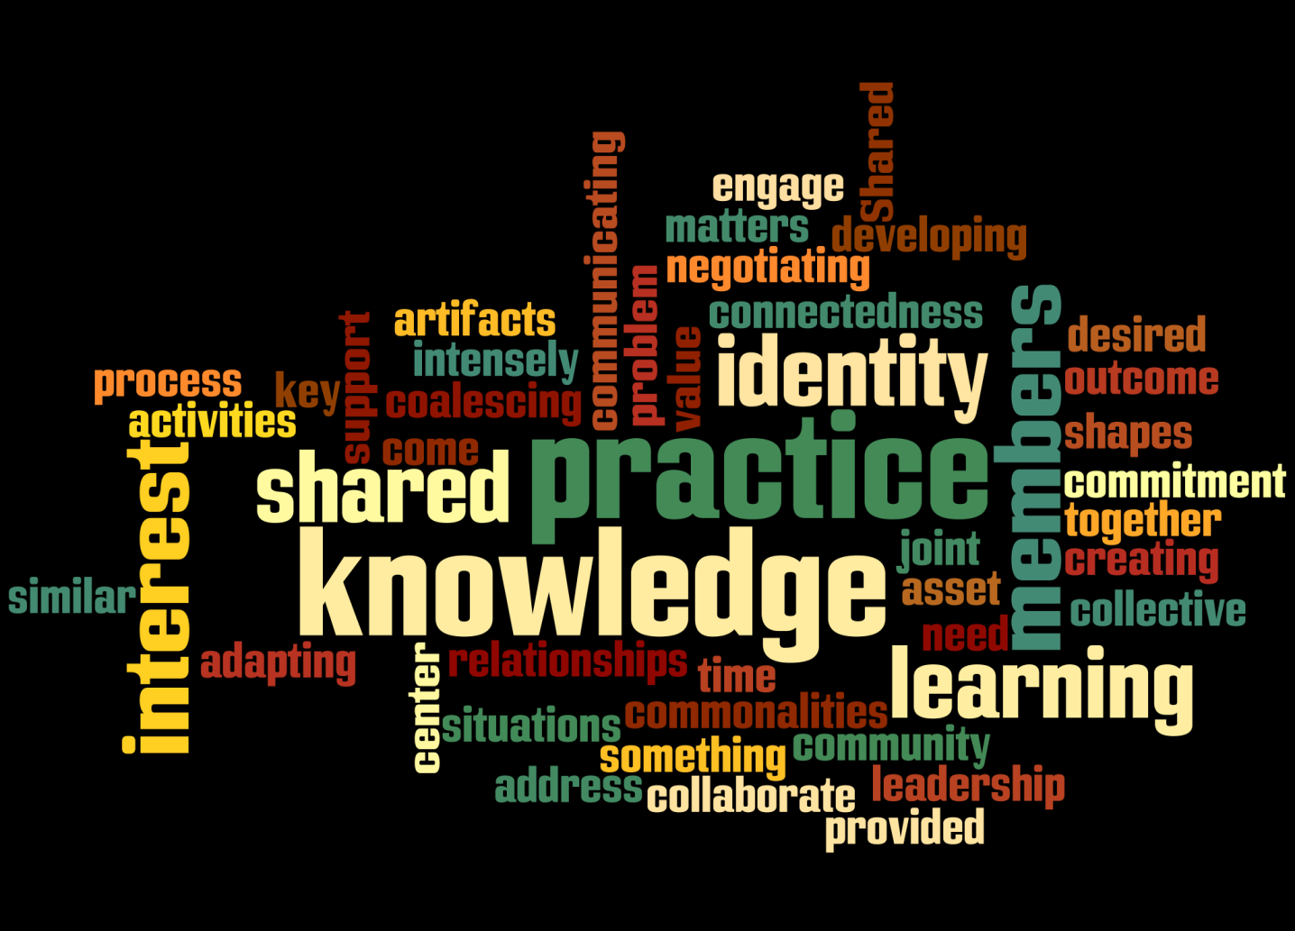
Moving from a Community of Talk…
…to a Community of Practice

Slide 3
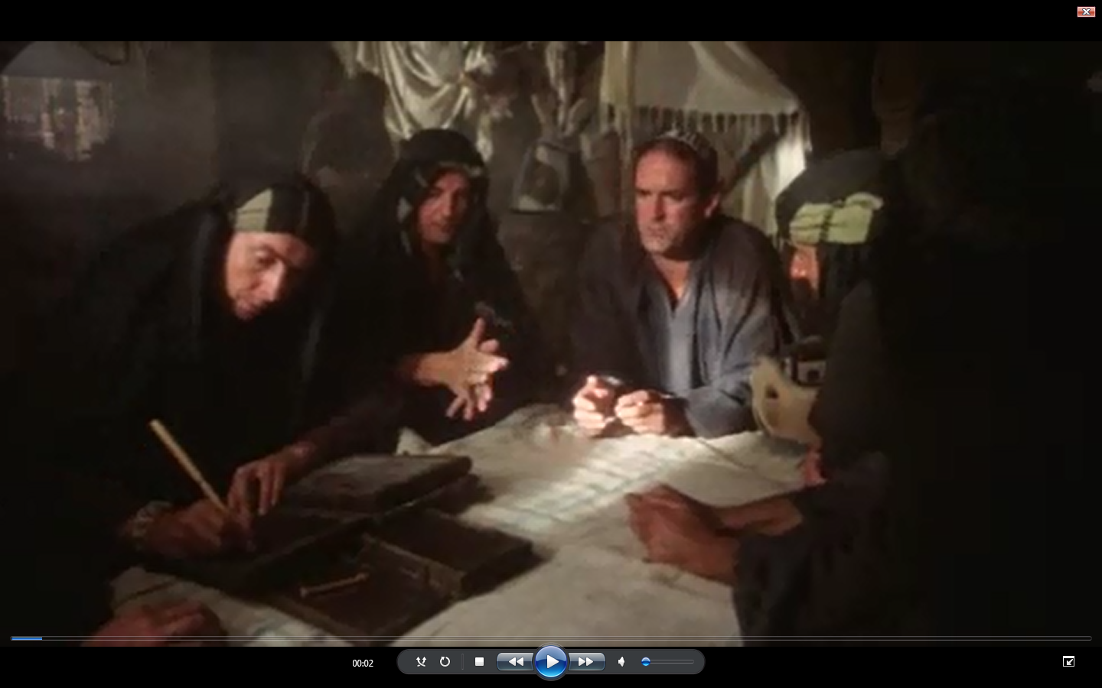

Slide 4
What are our Norms for today?
Select a recorder, timekeeper
Brainstorm at your table
What norms would you expect for an effective team
You have 1:38 .
Share out

Slide 5
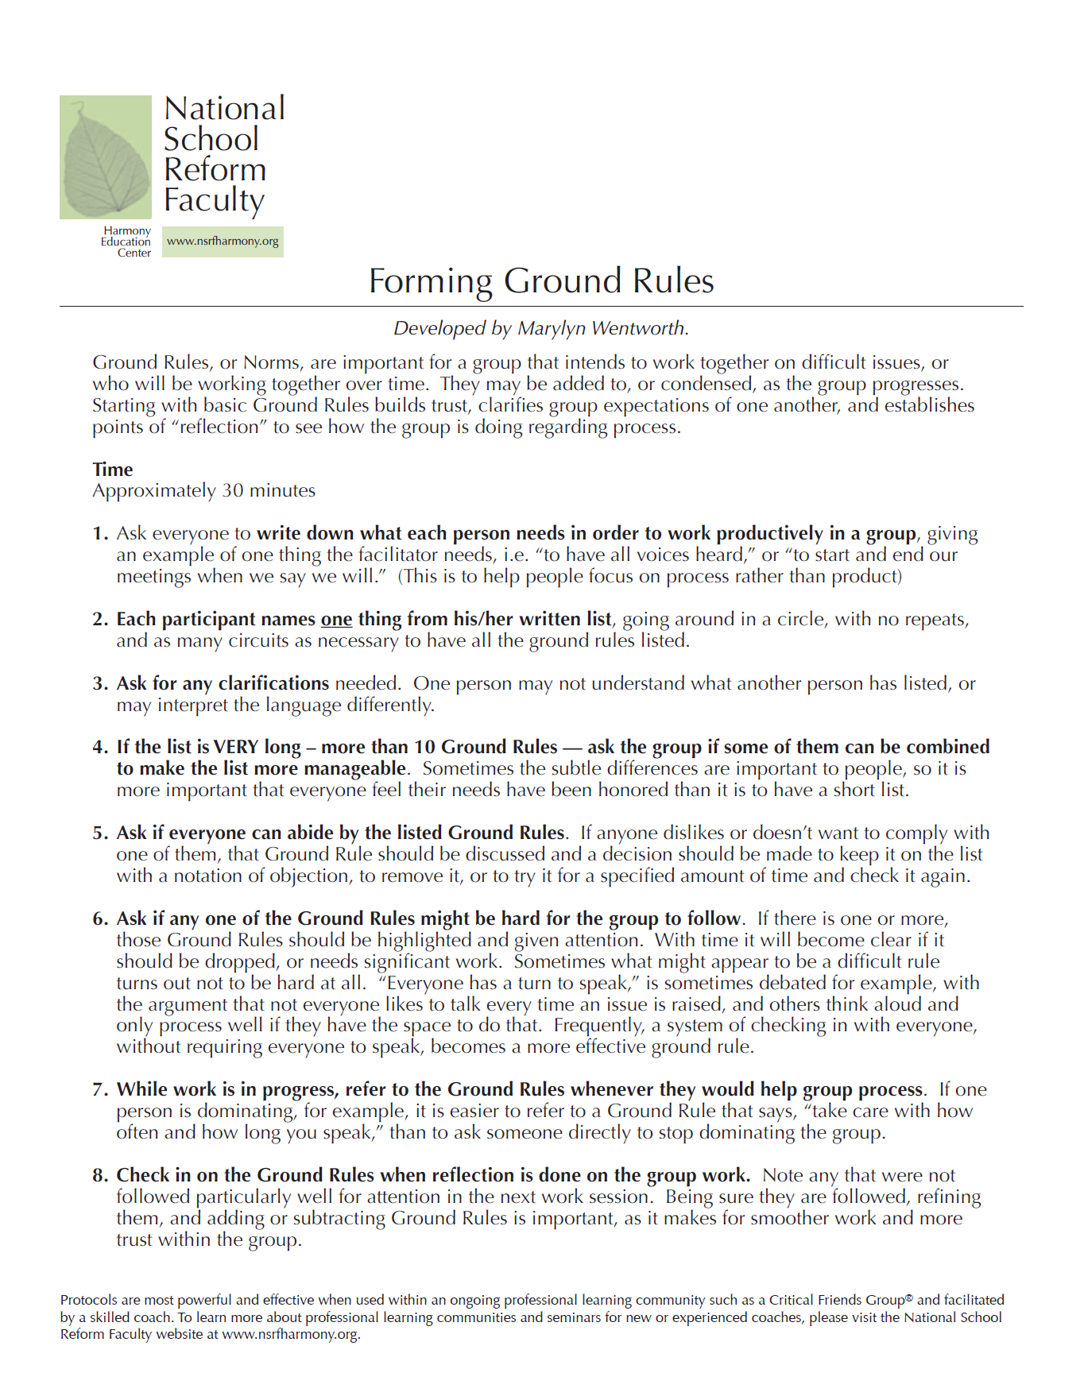
Tool Tip

Slide 6
What Are Norms?
Norms are:
Agreements generated by the team
Intended for all team members to uphold
Aligned with the function and context of the team
Subject to change and refinement as the team’s development or task changes
Revisited regularly as needed
Norms are not:
Rules for the facilitator to create and enforce
Rules for the administrator to create and enforce
Always transferable from one working team to another

Slide 7
Examples of Norms
Paying Attention to Self and Others
Awareness of our own and others’ thoughts and feelings
Respect confidentiality
Refrain from side bar conversations
Treat each other with kindness and respect
Active Listening
Deepen understanding by allowing think time, creating opportunities for paraphrasing, clarifying, and questioning
Equity of Voice
Value all ideas
Be aware of yourself and others’ level of participation

Slide 8
What is a Community of Practice?
A group of people who share common concerns, problems and goals, who focus on sharing best practices and creating new knowledge, who interact on an ongoing and regular basis, who develop a shared repertoire of resources, tools and ways of addressing problems, and who are dedicated to continuous improvement.

Slide 9
Essential Elements for Doing the Work
Team Norms
Effective meetings
Clear agendas
Clear roles and responsibilities to the team
Schedule topics
Focus on student work and pathway outcome attainment

Slide 10
Make a T-chart
Community of Practice
Effective Ineffective

Slide 11
Ineffective Groups
Think of a time when you worked in, or observed, a group that had difficulties functioning, getting things done, or achieving goals.
What were some of the roadblocks to them working more effectively?
Share with members of your team
What are some common themes; what comes up among all of you?
Write these common themes on the T-Chart.

Slide 12
Let’s Observe a Team in Action
What elements of an effective team are in place?
What are they talking about and doing during their team time?
What are they doing well?
What might they do differently?

Slide 13
DMD Video

Slide 14
Let’s Observe a Team in Action
What elements of an effective team are in place?
What are they talking about and doing during their team time?
What are they doing well?
What might they do differently?
Discuss at your table and add to T-chart.
Share out
What are the additional items observed in the video that you added to your T-chart?

Slide 15
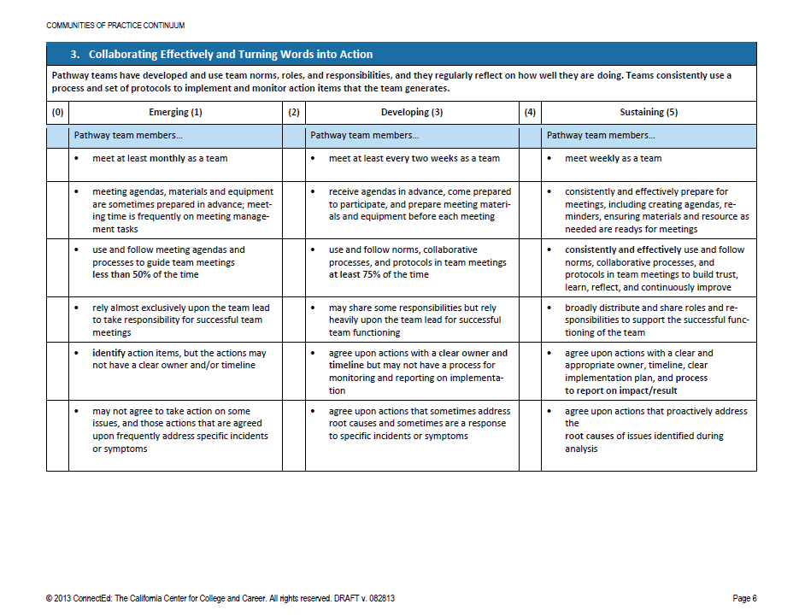
Building a Community of Practice
Look at the Community of Practice Continuum Page 6
By yourself, assess your team using handout.
Mark your answers on the chart with a colored marker.

Slide 16
Action Plan…
Where are you and your team/s on the Continuum?
Pathway team/s:
What actions can you take to move yourselves up to the “Sustaining” level on the rubric?
District and Site leaders:
What actions can you take to support pathway teams in moving up from Emerging to Sustaining on the rubric?

Slide 17
Facilitator Definition
A facilitator works in service of a group to accomplish a group outcome (e.g., analyzing data, making a decision). A facilitator doesn’t teach, present or advocate; rather, a skilled facilitator directs the group’s energy and processes so the group has emotionally safe and structured ways to engage in important work.

Slide 20
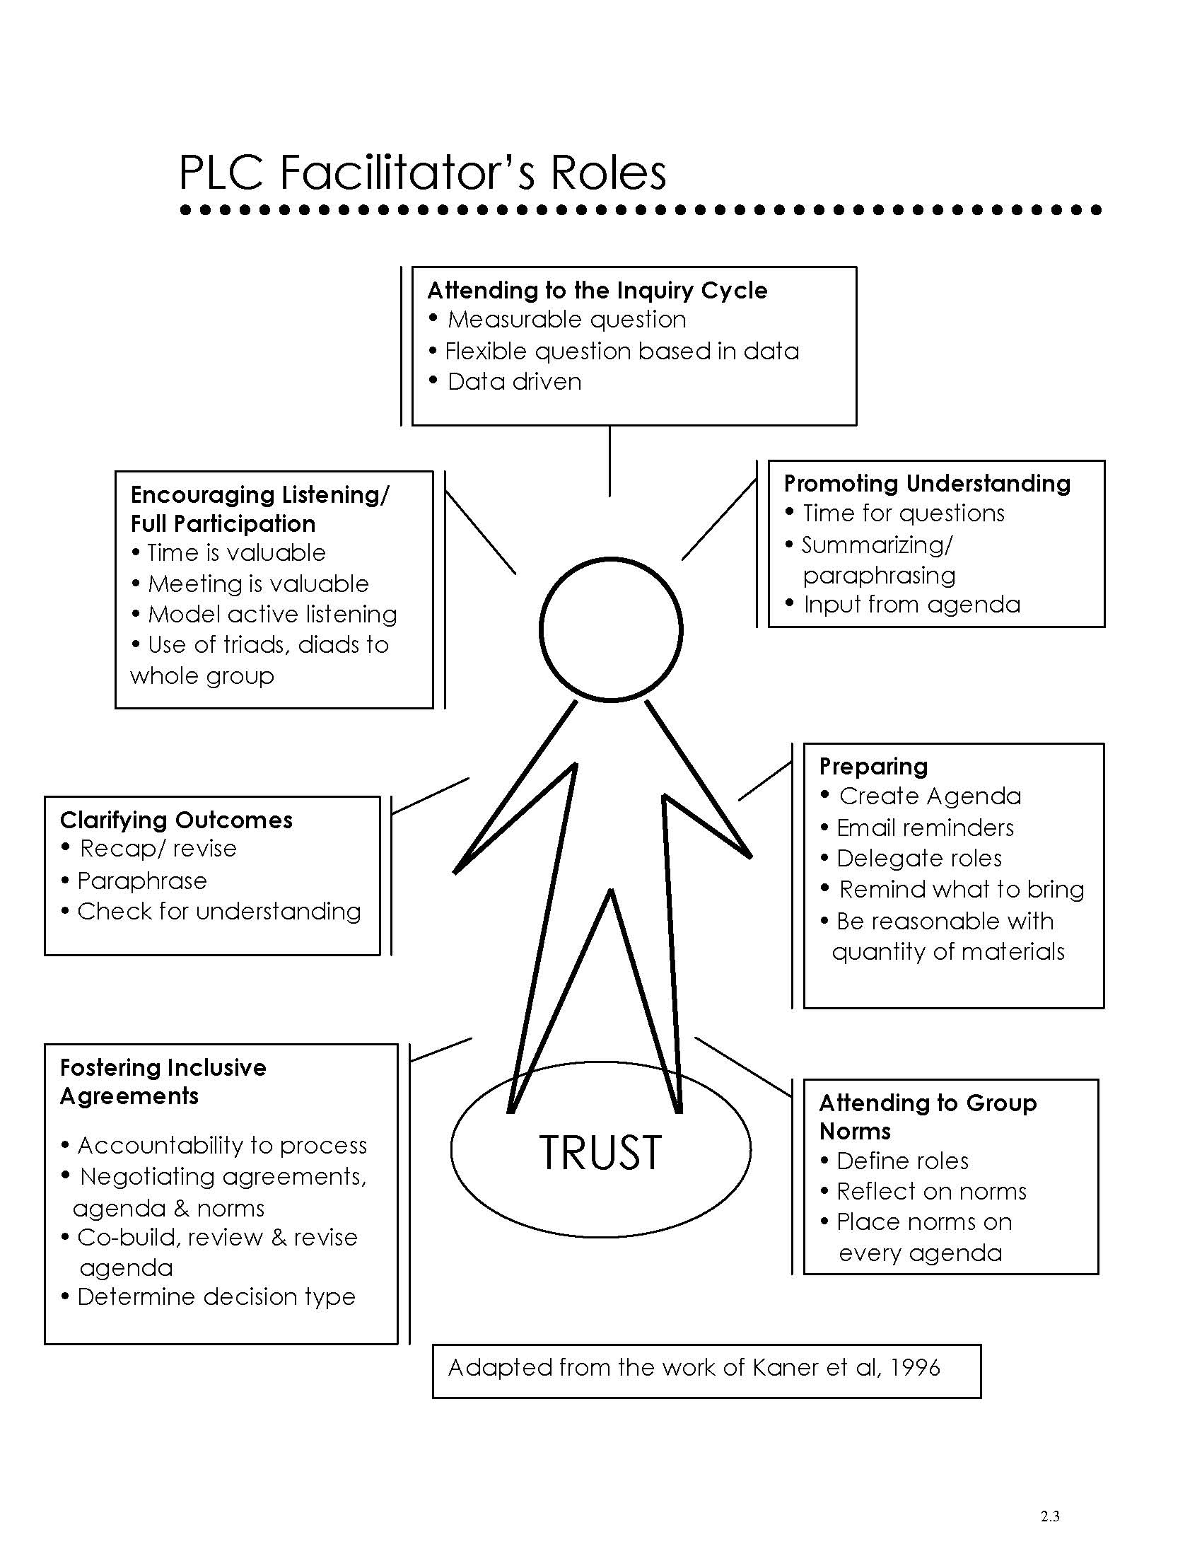
Facilitator’s Roles

Slide 22
Facilitator’s Roles
Preparing
Create Agenda
Fostering Inclusive Agreements
Co-build, review & revise agenda
Clarifying Outcomes
Paraphrase/Check for understanding
Attending to Group Norms
Reflect on Norms/Norms on Agenda
Define Roles
Promoting Understanding
Summarizing/paraphrasing
Encouraging Listening/Full Participation
Time is Valuable
Attending to the Inquiry Cycle
Data Driven

Slide 23
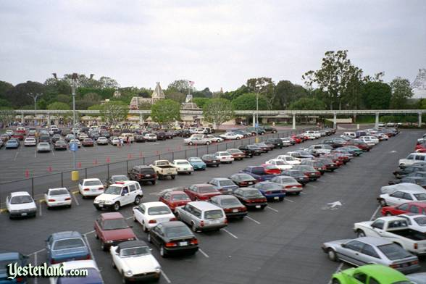
Tips and Strategies
Agendas: emerging, developing, sustaining?
Administrative Support
Process observer – are we doing what we said we would do?
Parking lot for what comes up unexpectedly/off agenda
Roles:
Time Keeper
Calendar Keeper
Is it the format or the content? (PAB)
Recorder/Note taker
Data person

Slide 24
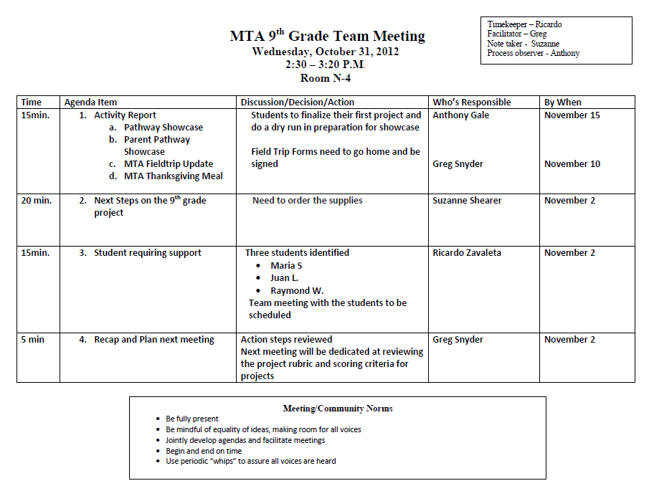
Set time and place
Shared Roles
Summary of actions
Clear Responsibilities
Clear Deadline
Reminder of Norms

Slide 25
Distributing Roles – Tips and Tools
Using the NEWS Activity
Action Oriented and Decisive
Organizers and Planners
“Big Picture” Folks
People Oriented

Slide 26
Who does what?
Read NEWS descriptions
Which are you most like or closest to?
Which direction fits best for which role on the team?

